Slide 1
Quiz Society
Week 4

Slide 2
Rules
Get into teams of 1-4 people
Have a piece of paper, a writing implement, and a team name prepared
There will be 5 rounds, with 6 questions per round
3 minutes per round
The team with the most points at the end wins

Slide 3
ROUND 1
FROM SOFTWARE GAMES
BUT I’VE ONLY PLAYED DARK SOULS: REMASTERED AND AT THE TIME OF MAKING THIS I HAVE JUST BEATEN THE BELL GARGOYLES SO IT WILL JUST BE ABOUT STUFF UP TO THAT POINT

Slide 4
QUESTIONS ABOUT DARK SOULS: REMASTERED
WHICH COMPANY PUBLISHED THE GAME?
WHAT IS THE FIRST BOSS OF THE GAME?
USE IT TO RESTORE IT
WHAT PHRASE IS ASSOCIATED WITH SOLAIRE?
WHERE DOES THE GAME TAKE PLACE?
WHAT IS THE MOST COMMONLY USED HEALING ITEM?

Slide 5
ROUND 2
TV SHOWS
FRIENDS

Slide 6
WHICH ACTOR PLAYS CHANDLER BING?
WHAT IS THE NAME OF THE THIRD EPISODE?
HOW MANY TIMES IS ROSS DIVORCED IN FRIENDS?
WHAT IS MONICA’S JOB IN FRIENDS?
WHAT IS THE TOTAL NUMBER OF EPISODES IN FRIENDS?
WHAT IS THE NAME OF ROSS AND RACHEL’S CHILD?

Slide 7
ROUND 3
RISK IT
FOR
THE BISCUITS

Slide 8
RULES
Earn bonus points by getting multiple answers correct
2 correct answers – 1 Bonus Point
4 correct answers – 2 Bonus Points
6 correct answers – 3 Bonus Points
HOWEVER
Get 1 question wrong, and score 0 points for the entire round
Leave an answer blank, and it is not counted as wrong

Slide 9

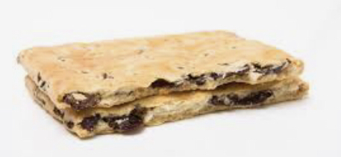
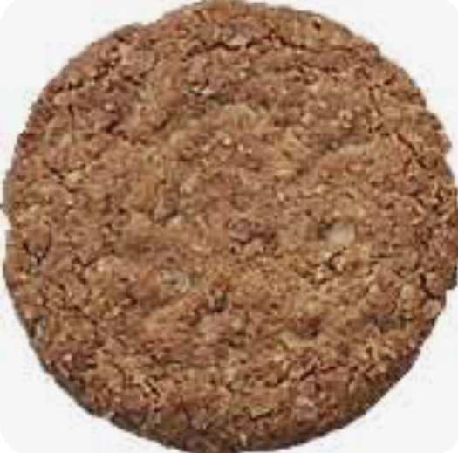

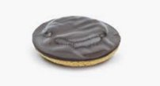
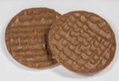
NAME THESE BISCUITS
1
2
3
4
5
6

Slide 10
ROUND 4
TECH COMPANY LOGOS
BUT I FORGOT THAT YOU CAN COPY AND PASTE OFF OF GOOGLE IMAGES AND I WAS IN A HURRY TO FINISH THIS ROUND

Slide 11
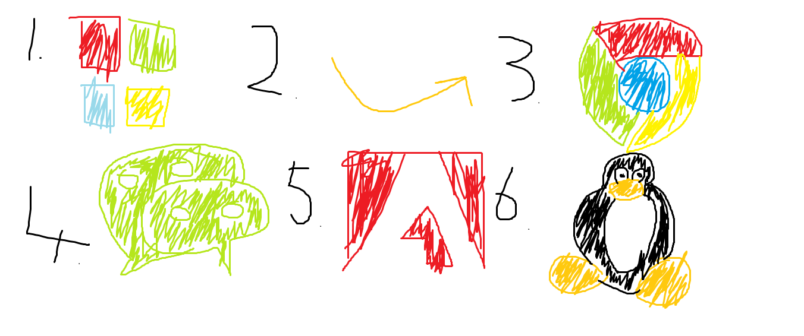
WHAT THE HELL AM I TRYING TO DRAW?

Slide 12
ROUND 5
CARS
BUT THE MANUFACTURERS ARE GONE

Slide 13
NAME THE MAKE OF CAR, WHICH IS MISSING ANY LETTER CONTAINED WITHIN THE NAME OF ITS MANUFACTURER
_IESTA
_VE_T_D__
B__T__
_STR_
_AY_NN_
C_R_LL_

Slide 14
SWAP YOUR PAPERS, IT’S ANSWER TIME
BONUS ROUND

Slide 15
WHAT’S NEXT?

Slide 16
WHAT COMES NEXT?
AVATAR AVENGERS:ENDGAME TITANIC

Slide 17
SWAP YOUR PAPERS, IT’S ANSWER TIME

Slide 18
ROUND 1
BANDAI NAMCO
ASYLUM DEMON
HUMANITY
PRAISE THE SUN!
LORDRAN
ESTUS FLASK

Slide 19
ROUND 2
MATTHEW PERRY
“THE ONE WITH THE THUMB”
THREE
CHEF
236
EMMA

Slide 20
ROUND 3
GARIBALDI
HOBNOB
JAFFA CAKE
PARTY RING
VIENNESE WHIRL
CHOCOLATE DIGESTIVE

Slide 21
ROUND 4
MICROSOFT
AMAZON
GOOGLE CHROME
WECHAT
ADOBE
LINUX

Slide 22
ROUND 5
FIESTA (FORD)
AVENTADOR (LAMBOURGHINI)
BEETLE (VOLKSWAGEN)
ASTRA (VAUXHALL)
CAYENNE (PORSCHE)
COROLLA (TOYOTA)

Slide 23
BONUS ROUND
AVATAR AVENGERS:ENDGAME TITANIC
STAR WARS:THE FORCE AWAKENS
THEY ARE THE HIGHEST GROSSING FILMS OF ALL TIME.

Slide 24
COUNT UP THE MARKS
RETURN THE PAPERS TO THEIR ORIGINAL TEAMS
ALL TEAMS REPORT YOUR SCORES
WAIT PATIENTLY WHILE A WINNER IS DECIDED
REVEL IN JOY IF YOU WIN

Slide 25
THE TOP 3 TEAMS MAY EACH SELECT A CATEGORY FOR NEXT WEEK’S QUIZ
A CATEGORY CANNOT BE SELECTED WITHIN TWO WEEKS OF IT BEING USED
AS FOR EVERYBODY ELSE, THANK YOU FOR COMING ALONG

